Slide 1
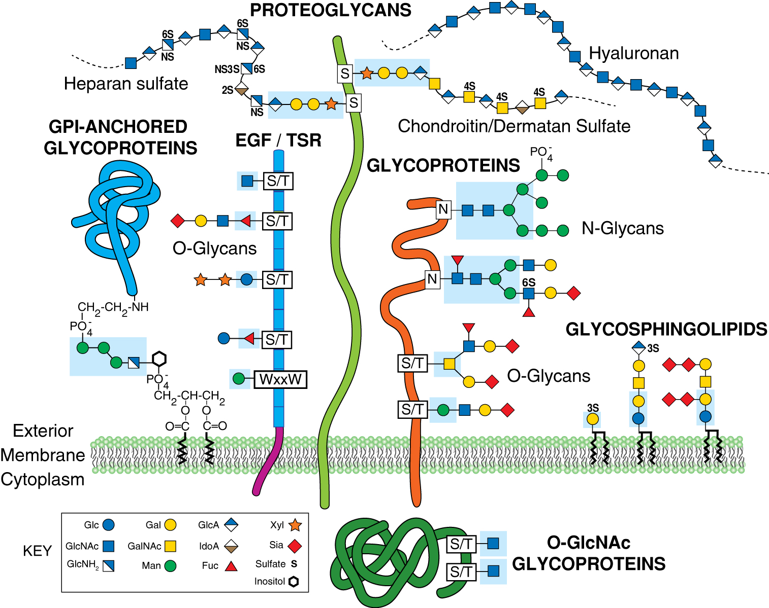


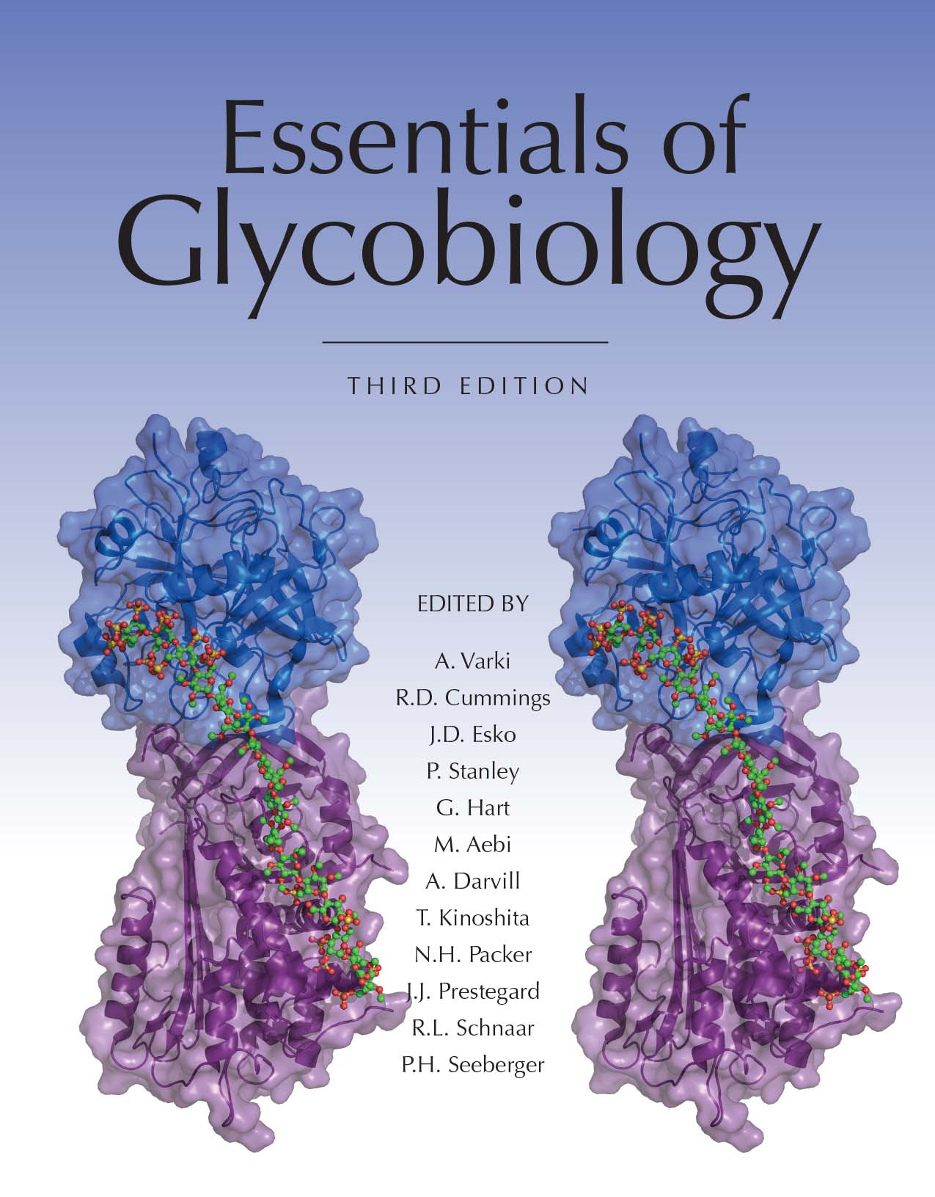
Common Classes of Animal Glycans
Chapter 1, Figure 6. Essentials of Glycobiology, Third Edition
Symbol Nomenclature for Glycans (SNFG)
Buy the Book
©2017 The Consortium of Glycobiology Editors, La Jolla, California
Notes:
FIGURE 1.6. Common classes of animal glycans. (Modified and updated from Varki A. 1997. FASEB J 11: 248–255; Fuster M, Esko JD. 2005. Nat Rev Can 7: 526–542, with permission from Macmillan; and Stanley P. 2011. Cold Spring Harb Perspect Biol 3: a005199. Original art has been adapted and redrawn by R.D. Cummings.) (See Online Appendix 1B for full names and designated symbols for monosaccharides.)
(Note: For a key to symbols used for monosaccharides, use the SNFG link. Embedded links are present but live only in the slide display mode.)

